Slide 1
Azure Service Bus

Slide 2
Introduction
Azure Service Bus is a fully managed enterprise message broker with message queues and publish-subscribe topics. Service Bus is used to decouple applications and services from each other, providing the following benefits:
Load-balancing work across competing workers
Safely routing and transferring data and control across service and application boundaries
Coordinating transactional work that requires a high-degree of reliability

Slide 3
Data is transferred between different applications and services using messages.
A message is a container decorated with metadata, and contains data. The data can be any kind of information, including structured data encoded with the common formats such as the following ones: JSON, XML, Apache Avro, Plain Text.

Slide 4
Ecosystem
Queues
Topics
Namespaces
Message sessions
Auto-forwarding
Dead-lettering
Scheduled delivery
Transactions

Slide 5
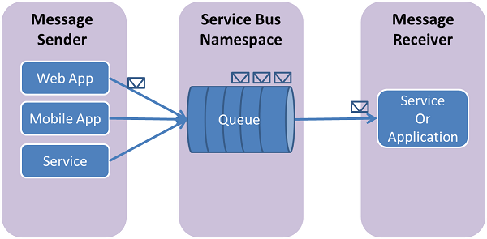
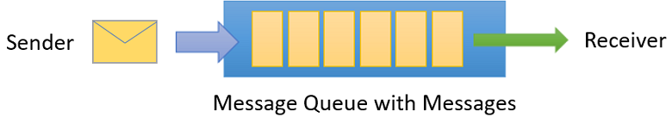
Queues
Messages are sent to and received from queues.
Queues store messages until the receiving application is available to receive and process them.

Slide 6
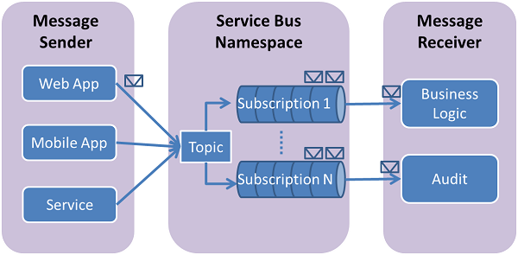
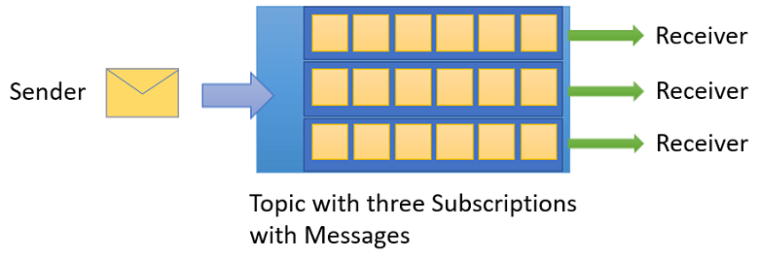
Topics
You can also use topics to send and receive messages.
While a queue is often used for point-to-point communication, topics are useful in publish-subscribe scenarios.

Slide 7
Demo

